Slide 1
Introduction to Multi-objective Optimization and Decision-making
Kalyanmoy Deb
Koenig Endowed Chair Professor
Michigan State University
East Lansing, USA
kdeb@egr.msu.edu
http://www.egr.msu.edu/~kdeb

Slide 2
Outline of the Tutorial
Multi-objective Optimization (MOO)
Evolutionary Multi-objective Optimization (EMO)
EMO Methods
EMO and Decision Making
Summary

Slide 3

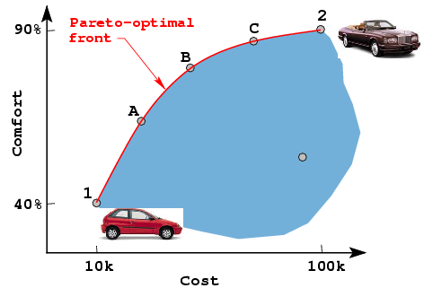
Multi-Objective Optimization: Basics
Bueno, Bonito, Barato?
Good,
nice,
cheap
Have you wondered?
3B
Efficient cars
Non-inferior cars
A doomed car
A “Dominated” car

Slide 4
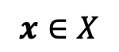
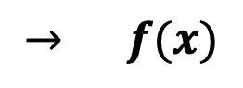

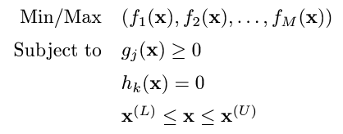
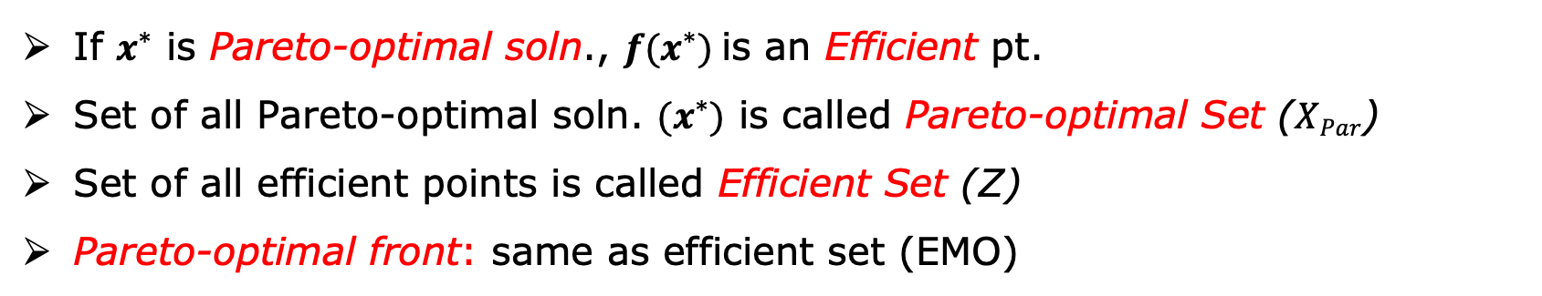
MOO as a Math. Programming Problem
Multiple objectives, constraints, and variables
$$→ f(x)$$
Optimal
Solution
}
Solution
$$≤$$
$$x∈X$$
Point
If $x^{∗}$ is Pareto-optimal soln., $f(x^{∗})$is an Efficient pt.
Set of all Pareto-optimal soln. ${(x}^{∗})$ is called Pareto-optimal Set ($XPar$)
Set of all efficient points is called Efficient Set (Z)
Pareto-optimal front: same as efficient set (EMO)

Slide 5
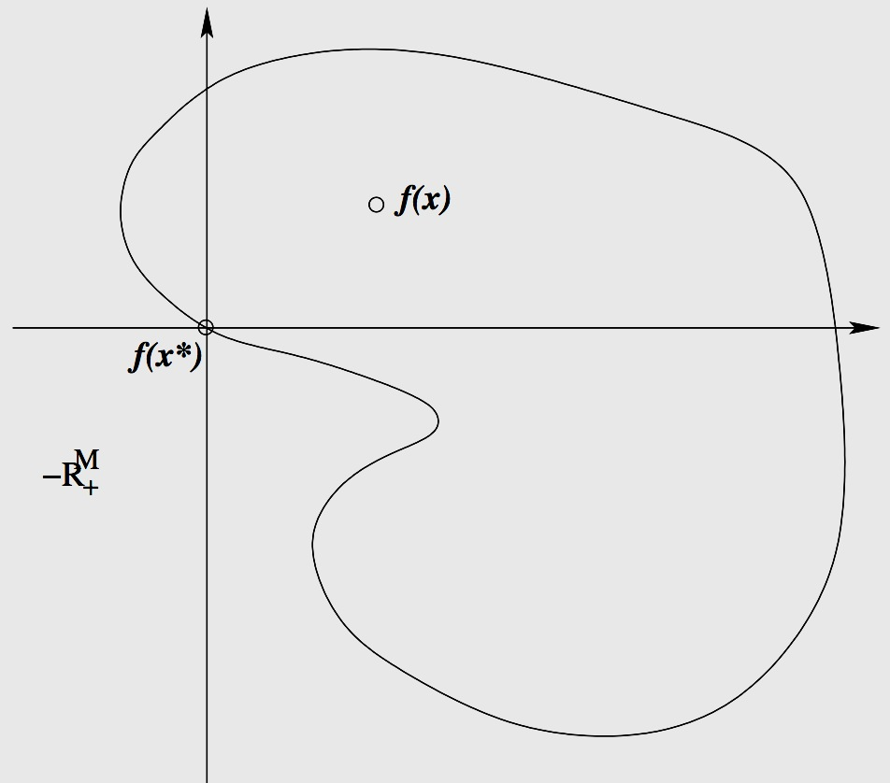


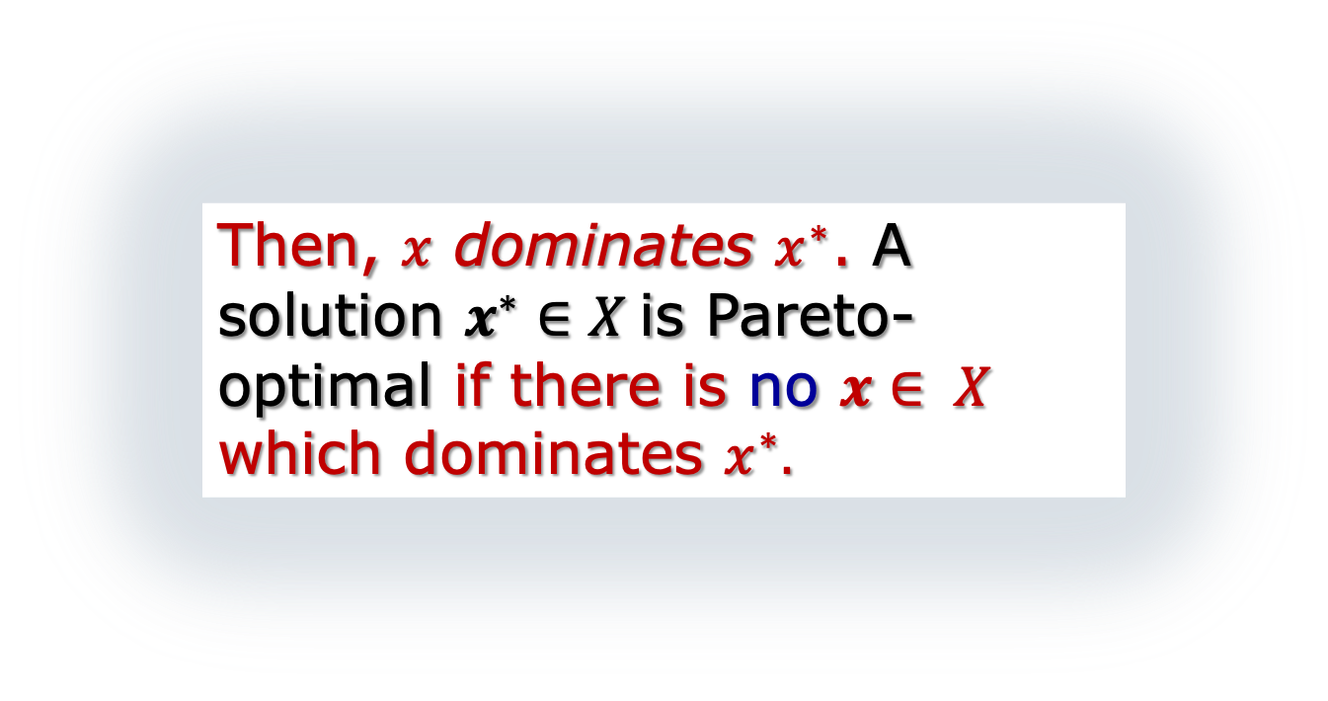
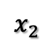
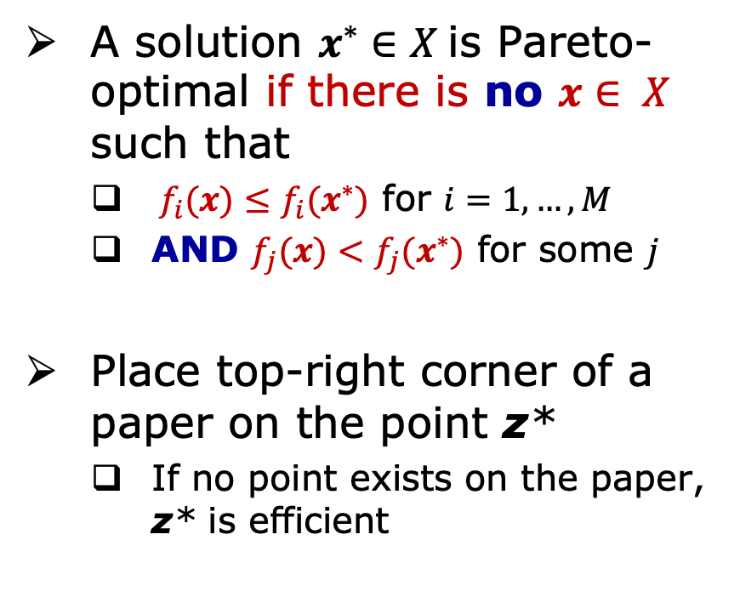
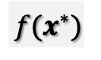
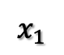

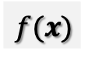


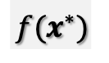
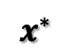
MOO Basics: Domination
$$x_{2}$$
A
$$X$$
X
Variable Space
$$x^{∗}$$
B
C
D
A solution $x^{∗}∈X$is Pareto-optimal if there is no $x∈ X$ such that
${ f}_{i}(x)≤f_{i}(x^{∗})$ for $i=1,…,M$
AND $f_{j}(x)<f_{j}(x^{∗})$ for some $j$
Place top-right corner of a paper on the point z*
If no point exists on the paper, z* is efficient
$$X$$
$$x_{1}$$
Objective Space
X
A
$$f(x^{∗})$$
$$Z$$
Then, $x$ dominates $x^{∗}$. A solution $x^{∗}∈X$is Pareto-optimal if there is no $x∈ X$ which dominates $x^{∗}.$
B
$$f(x)$$
No point should exist on axis lines as well
C
$$f(x^{∗})$$
D

Slide 6
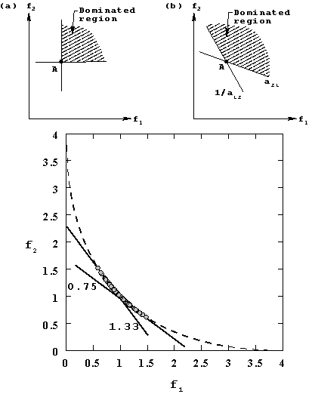
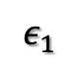
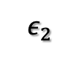
MOO Basics (cont.)
Other Domination Principles
Cone-Domination
Epsilon-Domination
One with larger number of better objectives dominate the other
Custom Domination principles possible
$$ε_{1}$$
A
$$ε_{2}$$

Slide 7
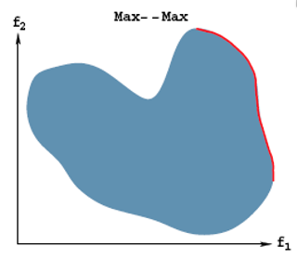
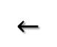
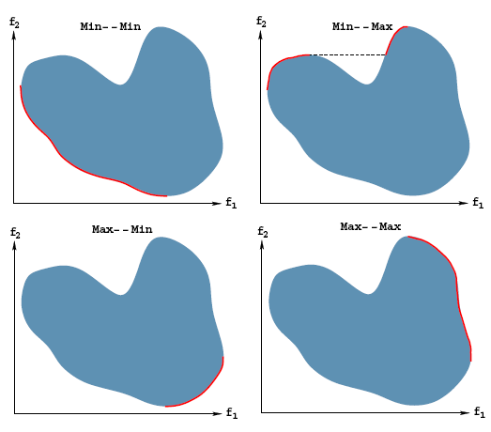
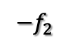
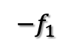
MOO Basics (cont.)
Mixed minimization-maximization
Change definition of domination, OR
Multiply Maximization objectives by -1 and treat all objectives to be minimized
$${−f}_{2}$$
$$←$$
$${−f}_{1}$$

Slide 8
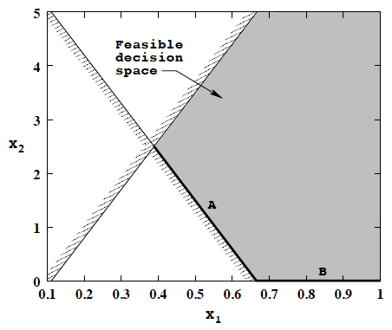
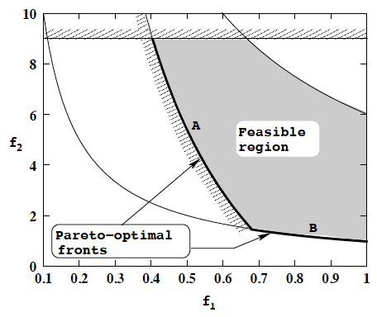
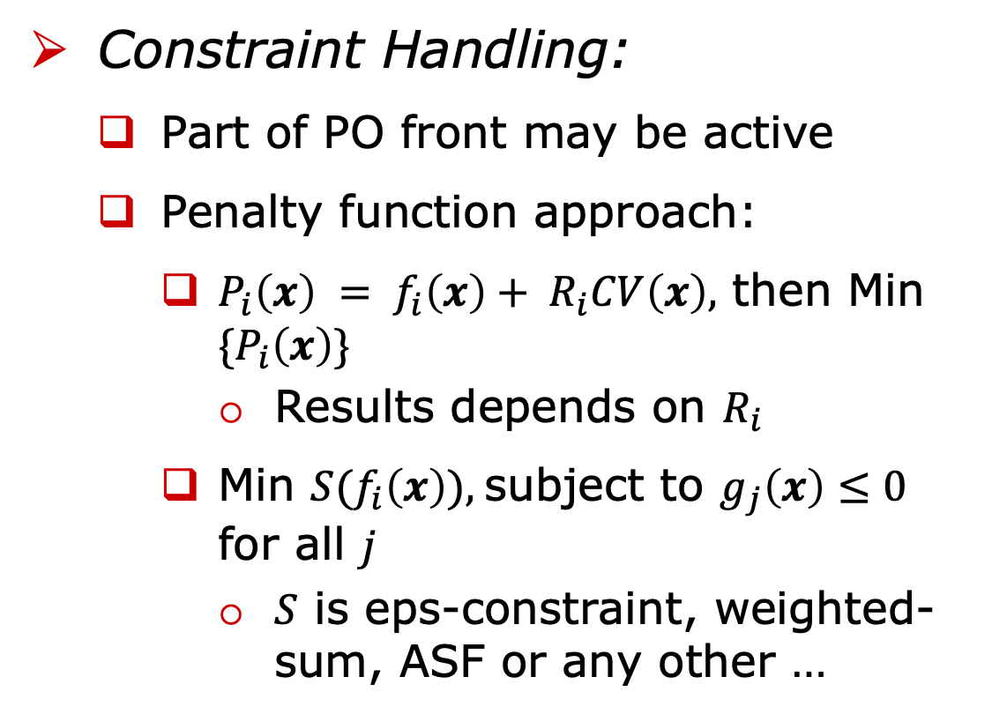
MOO Basics (cont.)
Constraint Handling:
Part of PO front may be active
Penalty function approach:
$P_{i}\left(x\right) = f_{i}\left(x\right)+ R_{i}CV\left(x\right),$ then Min ${\{P}_{i}\left(x\right)\}$
Results depends on $R_{i}$
Min $S(f_{i}\left(x\right)),$subject to $g_{j}\left(x\right)≤0$ for all $j$
$S$ is eps-constraint, weighted-sum, ASF or any other …
D
C
Unconstr.
minimum
C
D
Constr.
minimum

Slide 9
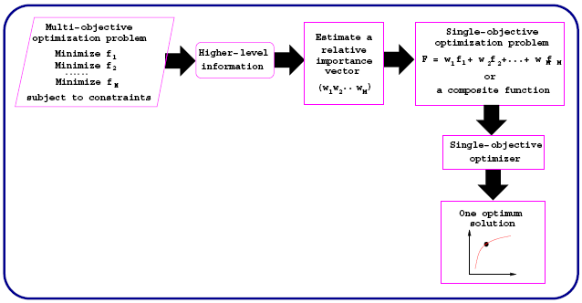
Classical MOO Principle
Results in a single solution in each simulation
Apply multiple times to generate an efficient set

Slide 10
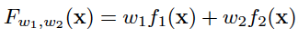
Classical Approach: Weighted-Sum Method
Construct a weighted sum of objectives and optimize:
User supplies weight vector w
Minimize:

Slide 11
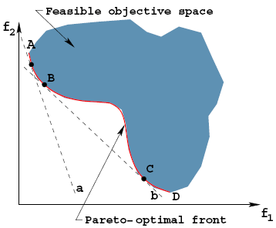
Difficulties with Weighted-Sum Method
Need to know w
Non-uniformity in Pareto-optimal solutions
Inability to find some Pareto-optimal solutions (those in non-convex region)
However, a solution of this approach is always Pareto-optimal

Slide 12
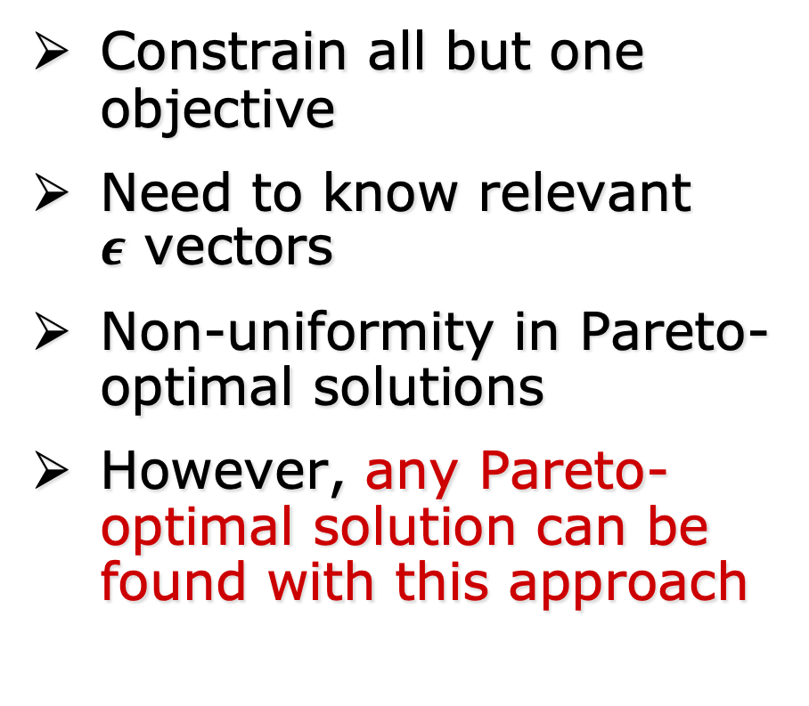
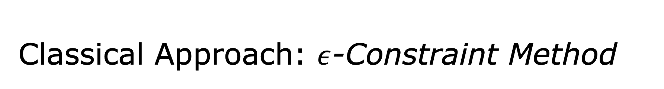
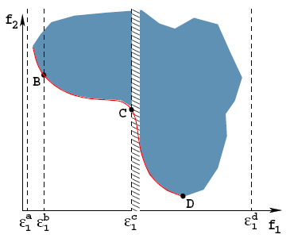
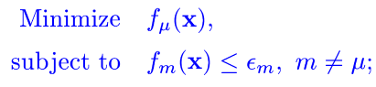
Classical Approach: $ε$-Constraint Method
Constrain all but one objective
Need to know relevant $ε$ vectors
Non-uniformity in Pareto-optimal solutions
However, any Pareto-optimal solution can be found with this approach

Slide 13
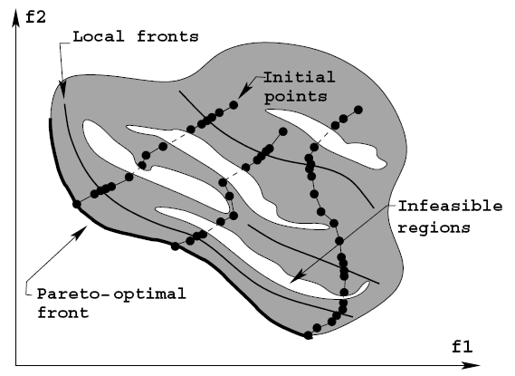
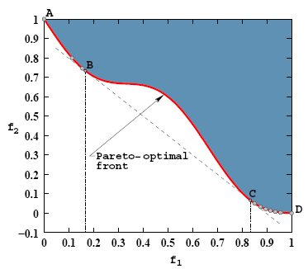
Difficulties with Classical Approaches
Need to run a single-objective optimizer many times
Expect a lot of problem knowledge
Multi-objective optimization treated as an application of single-objective optimization
Absence of any parallel search

Slide 14
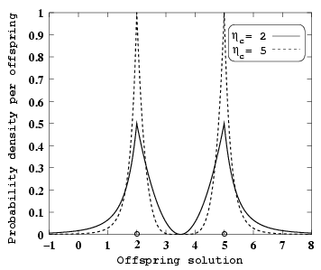
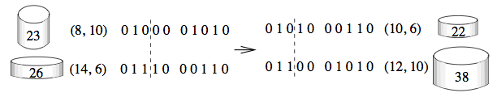
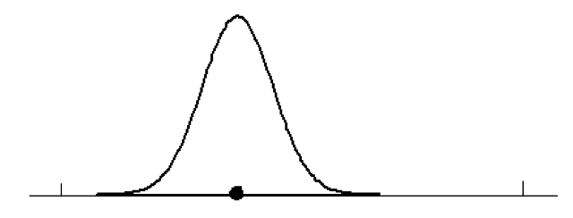
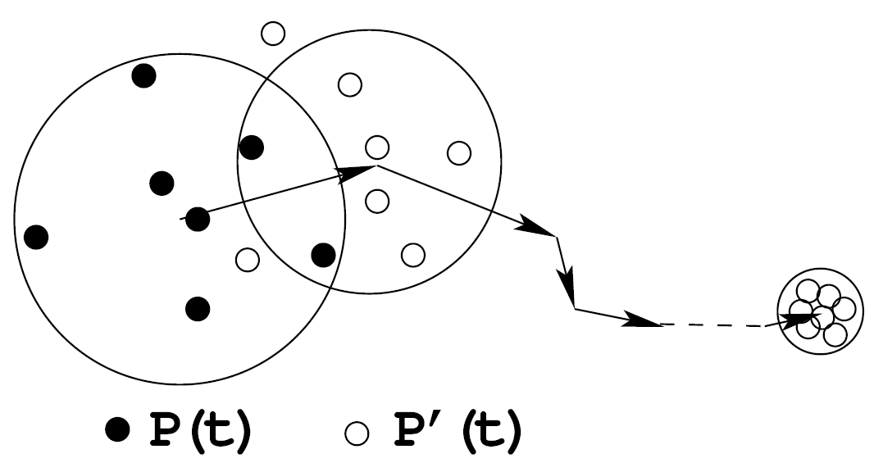
Evolutionary Algorithms as Population-Based Optimization Methods
(Since 1962)
Mean approaches optimum
Variance reduces
begin
Solution Representation
t := 0; // generation counter
Initialize P(t);
Evaluate P(t);
while not Terminate
do
P'(t) := Selection (P(t));
P''(t) := Variation (P'(t));
Evaluate P''(t);
P(t+1):= Survivor (P(t),P''(t));
t := t+1;
od
end
Initial
population
Optimum
Recombination:
Mutation:
Asymptotic Convergence Proof Exists (Rudolph, 1995)

Slide 15
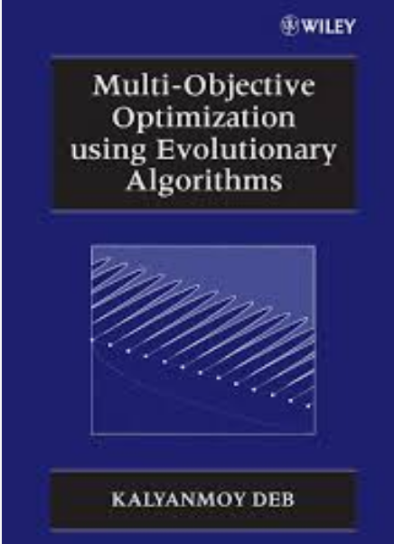
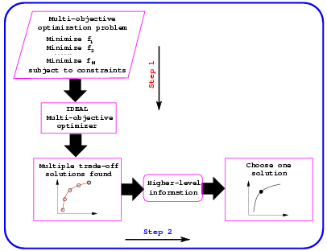
Evolutionary MOO (EMO): Basics
Step 1 :
Find a set of Pareto-optimal solutions
Step 2 :
Choose one from the set
Pragmatic approaches
Deb, K. (2001). Multi-objective optimization using evolutionary algorithms. Wiley
(First book on EMO, Google Scholar Citation: 20K+)

Slide 16
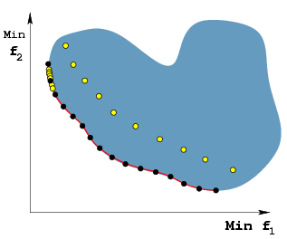
Three Goals in EMO
Converge to the Pareto-optimal front
Maintain as diverse a distribution as possible
Preserve elites for better performance

Slide 17
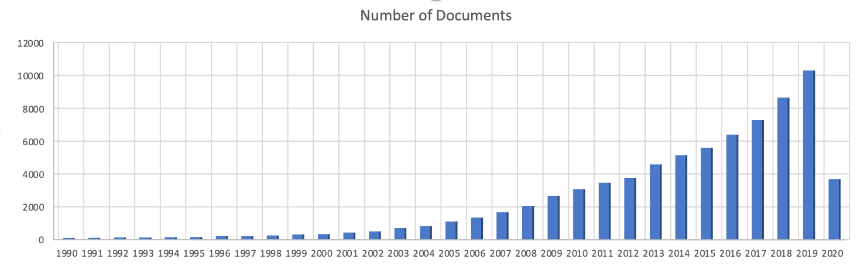
EMO: Early Methods
Early penalty-based approaches
VEGA (1984)
Goldberg's suggestion (1989)
MOGA, NSGA, NPGA (1993-95) used Goldberg’s suggestion
Elitist EMO (SPEA, NSGA-II, PAES, MOMGA etc.) (1998 -- Present)
10,297
NPGA
SPEA
NSGA-II
ℇ-MOEA
MOEA/D
NSGA-III
MOGA
NSGA
R-NSGA-II
SMS-MOEA

Slide 18
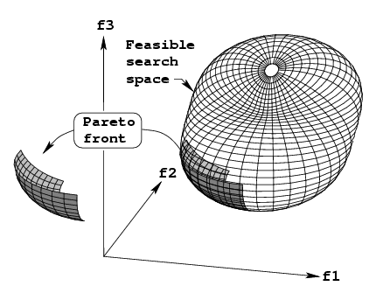
Elitist Non-dominated Sorting Genetic Algorithm (NSGA-II)
NSGA-II
Modular
No additional parameter
Fast
Commercialization:
Heeds (NSGA-II like)
ModeFrontier (Estico)
iSIGHT (Engeneous)
VisualDoc (Vanderplatts)
Fast-Breaking Paper in Engineering by ISI Web of Science (Feb’04), Thomson Citation Laureate Award 2006, Current Classic and Most Highly Cited Paper (>50,000+ Google Scholar citations)
Deb, K., Pratap. A, Agarwal, S., and Meyarivan, T. (2002). A fast and elitist multi-objective genetic algorithm: NSGA-II. IEEE Transaction on Evolutionary Computation, 6(2), 181–197

Slide 19
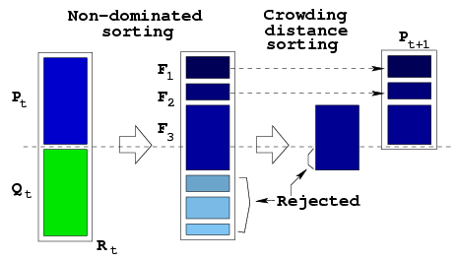
NSGA-II Procedure
TS_{(R,CD)}(A,B):
if R_{A} < R_{B}, choose A
if R_{B} < R_{A}, choose B
else //A & B non-dominated
if CD_{A} > CD_{B}, choose A
if CD_{B} > CD_{A}, choose B
else choose rand(A,B)
Elites are preserved
Non-dominated solutions are emphasized
Each soln has Rank R and Crowd. Dist. CD
TS(R,CD), Xover, Mut

Slide 20
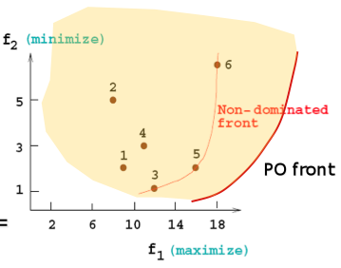
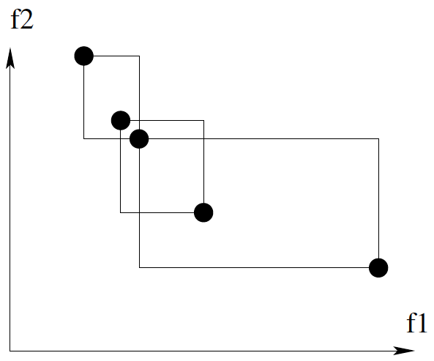
NSGA-II Procedure (cont.)
Emphasize for non-dominated points
Emphasize for less crowded points
No additional parameters needed

Slide 21
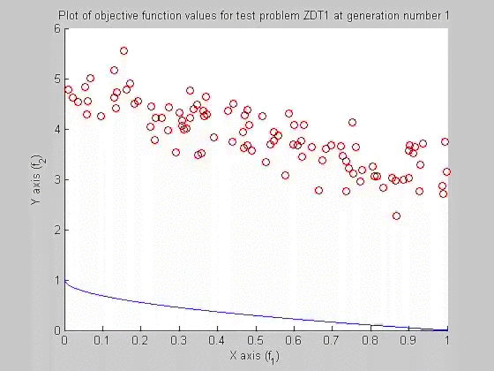
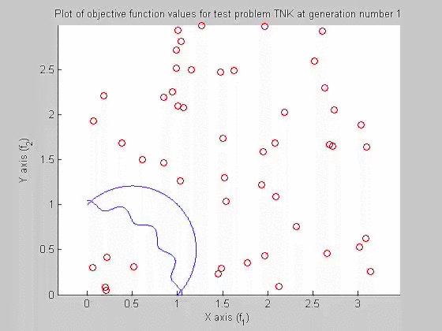
Example NSGA-II Simulations
Unconstrained 2-objective
Problem ZDT1
Constrained 2-objective
Problem TNK

Slide 22
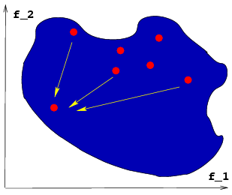
Why EMO Does So Well?
Population approach suits well to find multiple solutions
Niche-preservation methods can be exploited to find diverse solutions
Implicit parallelism helps provide a parallel search
Multiple applications of classical methods do not constitute a parallel search

Slide 23
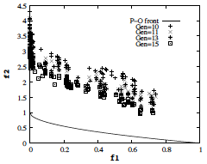

Why EMO Does So Well?
Population approach suits well to find multiple solutions
Niche-preservation methods can be exploited to find diverse solutions
Implicit parallelism helps provide a parallel search
Multiple applications of classical methods do not constitute a parallel search
NSGA-II with
A LS point

Slide 24

Evolutionary Many-Objective Optimization
Multi-objective: {2,3} objectives
Many-objective: >3 objectives
EMO difficulties for many-obj. problems:
Large fraction of population gets dominated
Dominant resistant solns.
Maintaining diversity difficult

Slide 25

Evolutionary Many-Objective Optimization
Multi-objective: {2,3} objectives
Many-objective: >3 objectives
EMO difficulties for many-obj. problems:
Large fraction of population gets dominated
Dominant resistant solns.
Maintaining diversity difficult

Slide 26
Evolutionary Many-Objective Optimization
Multi-objective: {2,3} objectives
Many-objective: >3 objectives
EMO difficulties for many-obj. problems:
Large fraction of population gets dominated
Dominant resistant solns.
Maintaining diversity difficult
Recombination operator inefficient
Representation of PO front requires exponentially more points
Performance measures difficult to compute
Visualization is difficult

Slide 27




Decomposition Based EMO:MOEA/D
Multiple reference lines
Random association at first
Points from neighboring (T) lines are mated
Offsprings are associated with a line based on min.
Offspring can replace r parents
Original study to 2-3 obj. Additional Param: T, 𝛳, r
Zhang, Q., & Li, H. (2007). MOEA/D: A multiobjective evolutionary algorithm based on decomposition. IEEE Transactions on evolutionary computation, 11(6), 712-731.

Slide 28

SMS-MOEA
Steady-state EMO
Multi-objective converted to a single-obj. optimization
Every ND point is computed for its hypervolume contribution
The worst one is deleted
Original Study: 2 and 3-obj problems with success
Use sample-based hypervolume metric for >3 objectives
Beume, N., Naujoks, B., & Emmerich, M. (2007). SMS-EMOA: Multiobjective selection based on dominated hypervolume. European Journal of Operational Research, 181(3), 1653-1669.

Slide 29


NSGA-III: Step 0: Supply of Reference Points
If no preference, use Das-and-Dennis’s approach
# pts.:
Else, supply a preferred set of reference points
Points are given on the normalized hyper-plane
Any other structured set of points can also be supplied
p=4, M=3, H=15
Deb, K. and Jain, H. (2014). Evolutionary Many-Objective Optimization Algorithm Using Reference-point Based Non-dominated Sorting Approach, Part I: Solving Problems with Box Constraints. IEEE Transactions on Evolutionary Computation, 18(4), 577–601.

Slide 30

NSGA-III: Step 0: Supply of Reference Points
If no preference, use Das-and-Dennis’s approach
# pts.:
Else, supply a preferred set of reference points
Points are given on the normalized hyper-plane
Any other structured set of points can also be supplied
p=4, M=3, H=15
Uniform
Unit-simplex
(Blank and Deb, 2020)
Deb, K. and Jain, H. (2014). Evolutionary Many-Objective Optimization Algorithm Using Reference-point Based Non-dominated Sorting Approach, Part I: Solving Problems with Box Constraints. IEEE Transactions on Evolutionary Computation, 18(4), 577–601.

Slide 31

NSGA-III: Step 1: Identification of Non-dominated Fronts
Parent and offspring population combined to R
Non-dominated sorting of R
Collect and save fronts 1 to l to S, delete other fronts
If |S|=N, P_{t+1} = S, go to next iteration
Else, P_{t+1} = {F₁,…,F_{l-1}}, remaining pts chosen from F_{l}
F_{l}
P_{t+1}
N=7
Deb, K. and Jain, H. (2014). Evolutionary Many-Objective Optimization Algorithm Using Reference-point Based Non-dominated Sorting Approach, Part I: Solving Problems with Box Constraints. IEEE Transactions on Evolutionary Computation, 18(4), 577–601.

Slide 32


NSGA-III: Step 2: Normalization of Population Members
Identify ideal point of S
Translate all members of S to make new ideal pt. as origin
Identify extreme pts.:
Update with previous extreme pts.
Normalize using ideal and extreme points obtained
Deb, K. and Jain, H. (2014). Evolutionary Many-Objective Optimization Algorithm Using Reference-point Based Non-dominated Sorting Approach, Part I: Solving Problems with Box Constraints. IEEE Transactions on Evolutionary Computation, 18(4), 577–601.

Slide 33
NSGA-III: Step 2: Association of Population Members
Reference line for each ref. pt. is found
The ref. pt. having shortest perpendicular dist. from a S member is associated
A reference point may have zero, one, or more than one S members associated
Deb, K. and Jain, H. (2014). Evolutionary Many-Objective Optimization Algorithm Using Reference-point Based Non-dominated Sorting Approach, Part I: Solving Problems with Box Constraints. IEEE Transactions on Evolutionary Computation, 18(4), 577–601.

Slide 34

Simulation of NSGA-III on 3-Obj. Problem
Deb, K. and Jain, H. (2014). Evolutionary Many-Objective Optimization Algorithm Using Reference-point Based Non-dominated Sorting Approach, Part I: Solving Problems with Box Constraints. IEEE Transactions on Evolutionary Computation, 18(4), 577–601.

Slide 35





More Results of NSGA-III
10-obj.
Problem
Crashworthiness
A few
Solutions
Constrained
Problem
Constrained
Problem
Deb, K. and Jain, H. (2014). Evolutionary Many-Objective Optimization Algorithm Using Reference-point Based Non-dominated Sorting Approach, Part I: Solving Problems with Box Constraints. IEEE Transactions on Evolutionary Computation, 18(4), 577–601.

Slide 36

EMO and Decision Making
Finding a P-O set (using EMO) is half the story
How to choose one preferred solution (MCDM)
A-priori approach:
First MCDM, then EMO
A-posteriori approach:
First EMO, then MCDM
Interactive approach:
MCDM during EMO
Branke, J., Deb, K., Mietinnen, K. and Slowinski, R. (Eds.) (2008). Multiobjective optimization: Interactive and evolutionary approaches. Hiedelberg, Germany: Springer.

Slide 37


Making Decisions: A-priori or A-Posteriori
Ranking based on closeness to each reference point or a reference direction
R-NSGA-II: Deb and Sundar (GECCO 2006)
Notes:
Posteriori

Slide 38


Making Decisions: A-priori or A-Posteriori
Ranking based on closeness to each reference point or a reference direction
RD-NSGA-II: Deb and Kumar
(GECCO-2007)
’Light Beam’ Approach
(CEC-07)
Notes:
Posteriori

Slide 39


A-Posteriori Approaches
Select a preferred Pareto solution
Compromise Programming:
Need a reference point
Usually the ideal point
Quite common in practice

Slide 40



A-Posteriori Approaches (cont.)
Trade-off Approach
Recent Applications
Pseudo-weight Approach
Choose a solution close to desired weight combination
Trade-off = $\frac{Loss}{Gain}$
Desired weight
(0.67,0.33)

Slide 41
EMO for Handling Practicalities
Metamodeling based EMO
Uncertainty handling EMO
Distributed computing in EMO
Redundant objectives in EMO
Dynamic EMO
Bilevel (Hierarchical) EMO
Mixed nature of variables

Slide 42

Innovization (Knowledge Discovery)
Variables of Pareto set often contain patterns
Due to optimality conditions each solution must satisfy
Machine learning to extract patterns (features)
NAS: Subnet is common or certain weights are identical in all Pareto solutions
Reoptimization to speed-up task

Slide 43
Summary
Multi-objective optimization allows a pragmatic way to find alternate solutions
Alternate solutions can be used to extract patterns
Problem knowledge for future use
Speed-up optimization task
Commercial softwares available
Heeds, ModeFrontier, iSight, VisualDoc
Computer codes freely downloadable
pymoo, Jmetal, PISA, MOEAFramework, EMOO websites

